Slide 1
UE18CS390A – Project Phase – 1
End Semester Assessment
Project Title : Smart Classroom Environment
Project ID : 71
Project Guide : Dr. Annapurna D
Project Team : Akshaya Visvanathan (PES2201800089)
Bhavan Naik (PES2201800047)
Akhil S Kumar (PES2201800137)
Atharva Moghe (PES2201800131)

Slide 2
Agenda
Introduction and Motivation
Problem Statement
Abstract and Scope
Literature Survey / Existing System
Suggestions from Review – 3
Requirements Specification
Design Approach
Design Constraints, Assumptions & Dependencies
Proposed System / Approach
Architecture
Design Description
Project Progress
References

Slide 3
Introduction and Motivation
For years, universities have been using traditional methods as they bring about a sense of familiarity and comfort.
However, the key to increase the productivity and enhance the learning experience lies in the modernization of our college campuses.
Our work focuses on two of the most pressing issues - attendance and unsolicited energy consumption.
Our goal was to overhaul the manual system, without compromising its integrity.

Slide 4
Problem Statement
A proposal for an IoT-based intelligent environment, with the primary objective of energy optimization and an intelligent, yet reliable attendance system that focuses on reducing latency to give an enhanced learning experience.

Slide 5
Abstract and Scope
Abstract:
For a long time, attendance has always been taken manually. This has caused multiple discrepancies and has wasted useful class time.
In addition to this, classroom equipment like fans etc. have occasionally been left on thereby wasting considerable energy.
Scope:
We are planning to firstly implement this project in our own campus and then extend it to other institutions.

Slide 6
Literature Survey
Paper Details | Objective of paper, Techniques/Methods | Advantages | Limitations
https://ieeexplore.ieee.org/abstract/document/8433537 | Smart Attendance Monitoring System (SAMS): A Face Recognition Based Attendance System for Classroom Environment | Automatic attendance management system for convenience or data reliability. | Highly Time Consuming and Insecure.
https://ieeexplore.ieee.org/abstract/document/7892666 | Automatic lighting and Control System For Classroom | Automatic lighting and control using Arduino for the efficient use of energy in Classroom condition. | Manual switch ON and OFF option not available.
https://ieeexplore.ieee.org/abstract/document/7311993 | Smart University: A New concept on the Internet of Things | Create a sustainable campus environment that helps build a cohesive learning experience. | Loss of data due to volume generated and transmission via MCS.

Slide 7
Literature Survey
Paper Details | Objective of paper, Techniques/Methods | Advantages | Limitations
https://ieeexplore.ieee.org/abstract/document/8821515 | Smart attendance system based on frequency distribution algorithm with passive RFID tags. | Strong anti-interference capability and non-intrusiveness. | Easy for students to find loopholes.
https://ieeexplore.ieee.org/document/8519856 | IoT-Aided Charity: An Excess Food Redistribution Framework | Food Waste Reduction and Management. | Heavily affected by external factors like time and transportation.

Slide 8
Summary of Literature Survey
The use of Internet of Things in the advanced world is the focal point of enthusiasm of numerous analysts and standardization bodies since quite a long while. The project will introduce the total adaptation of approaches of an intelligent classroom framework. We will likewise introduce a composition of the proposed model.
As a conclusion of extensive literature survey, we have curated the following results:
In general, campuses spread over a fairly large area and it is very difficult for management to track everything that happens. Daily, thousands of students, teachers and visitors can be present into a university, each with at least an object connected to the Internet, smartphone or tablet. This forms a highly interconnected network that operates over an Mobile Crowd Sensing network and generates an immense volume of data. Patterns and predictions can be made from this varied data.

Slide 9
Summary of Literature Survey
Attendance information has always been an important part of university management. However, some opportunistic students may consign others to punch their timecards, which hampers the authenticity of attendance and effectiveness of record keeping. The existing manual system is time consuming and prone to by passing. Hence, it is necessary to develop an innovative anti-cheating system for attendance.
Most of colleges and universities use the traditional lighting system where we have a switch to control the lighting. Most of us i.e., students and faculty members are habituated towards leaving the classroom without switching the lights and fans, which leads to unnecessary consumption of energy for organization and paying huge amount of bill from their budget.
The system developed will control lighting in particular area of classroom based on the presence of human using relay control compared to the one placed in ceiling which would switch on or off based on presence of human in room irrespective of position.

Slide 10
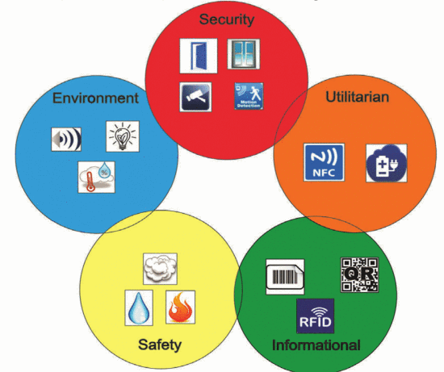
Summary of Literature Survey
Type of Sensors that Can Be Used in a Smart University:
Sensors and technologies can be identified depending on their usefulness in a university campus; then they can be used and after that split in the following categories:
EN (environment): noise, humidity, temperature, light;
SC (security): motion detection, window / door open / closed, video, fingerprint;
SF (Safety): smoke / gas, fire, water, radiation;
UT (utilitarian): NFC tags, electrical voltage;
IN (information): Barcode. OR tags. RFID card.

Slide 11
Summary of Literature Survey
A trusted and active community aided and supported by the Internet of Things (IoT) is a key factor in food waste reduction and management. Our paper proposes an IoT based context aware framework which can capture real-time dynamic requirements of both vendors and consumers and perform real-time match-making based on captured data.
We describe our proposed reference framework and the notion of smart food sharing containers as enabling technology in our framework. A prototype system demonstrates the feasibility of a proposed approach using a smart container with embedded sensors.

Slide 12
Suggestions from Review - 3
Provide the suggestions and remarks given by the Guide:
Budget of the Project.
Implementation of the Project.
Mention the feasibility on the same showing the progress:
Budget plans have been laid out.
Delay in procuring hardware components in light of the current pandemic situation.

Slide 13
Requirements Specification
Optical Biometric Sensor module: to record individual fingerprints.
Spatial sensors: to check which part of the room is occupied to make the system spatial aware.
Raspberry Pico microcontroller: to manage per classroom function at the edge of the network.
WPF/UWP: to make the dashboard application for administrator management.

Slide 14
Design Approach
The assortment IoT sensors installed in the classrooms are durable and need not be replaced often.
The server installation too is a one-time process. However, the ThingSpeak and Firebase backends need to be paid for on a yearly basis depending on the usage.
The ML models used for attendance summarization and fan speed detection are reused and some extra layers(mechanism) have been added on top of that. These models are constantly learning from manual user intervention.

Slide 15
Design Constraints, Assumptions & Dependencies
Availability of Raspberry Pico:
Raspberry Pico is very new to the market and needs to be tested whether it satisfies all the requirements for the project.
Server systems in the Institutions:
Our project also highly depends upon how the server system exists at a particular institution. If there is no existing server, it would be very easy to implement.
Existing Wiring in Institutions:
It depends which wiring system exists at the institution because our project would work on almost every existing wiring system unless it’s very old.

Slide 16
Design Details
Novelty/ Uniqueness of the Project:
Automated yet reliable attendance system that would help improve classroom learning. Fool proof solution is important keeping in mind the innovative ways students find to bypass attendance systems.
Real-time implementation that is independent of the wiring system and hence may be extended to Government schools and colleges, in order to reduce their electricity costs.
Help reduce harmful effects of unsolicited energy consumption on the environment and save our planet for future generations.

Slide 17
Attendance:
Attendance can be taken electronically by means of a biometric optical fingerprint scanner.
Security and integrity can be ensured by making the biometric module portable and modular - a small phone sized module carried by the teachers.
The teacher can pass around/have each of the students scan their prints and register their attendance with no manual intervention.
Proposed Methodology / Approach -1

Slide 18
Proposed Methodology / Approach -2
Electricity Optimization:
Spatial sensors placed at the edges of classrooms will notify the system of movement and activity in the room.
Edge computed algorithms ensure that the lights and fans are turned on only at specific portions of the room incase of a large classroom/hallway.
In case of manual fans, temperature monitors are used to add a level of cost-effective automation.

Slide 19
Architecture
User Groups:
Teachers
Students
Administrator
Application Components:
Attendance Logging Component
Power Component
Temperature Modulation Component
Database Component
Data Components:
Raw Fingerprint Data
Power Consumption Values
Current Room temperature
Database connectors

Slide 20
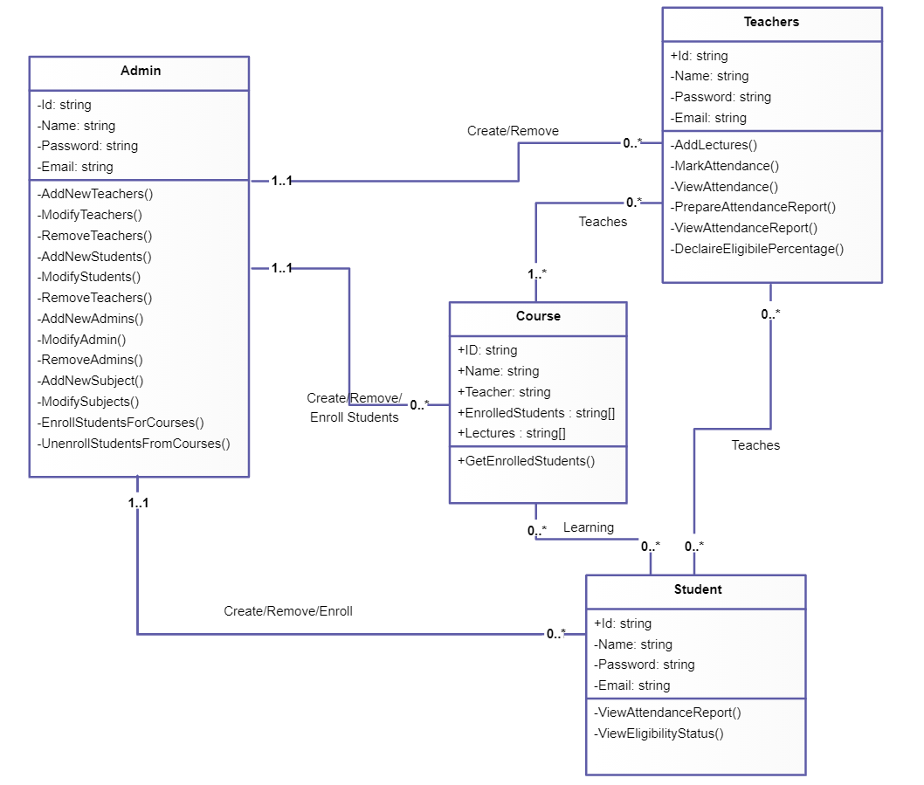
Design Description
Class Diagram:

Slide 21
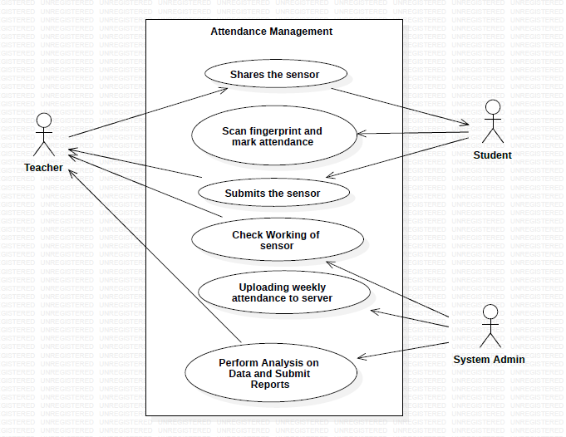
Design Description (if applicable)
Use-Case Diagram:

Slide 22
Project Progress
Progress so far:
Literature Survey
Architecture Proposal
Desired Changes
3 Reviews accompanying documentation
CapStone Phase-1 Report (along with its Plagiarism Report)
What is the percentage completion of the project?
- 30%

Slide 23
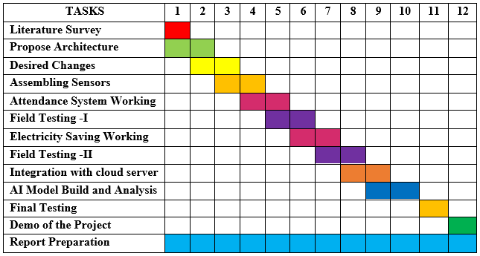
Capstone (Phase-I & Phase-II) Project Timeline

Slide 24
Any other information
Hardware Requirements:
• UART Capacitive Fingerprint Sensor
• Digital temperature controller thermostat (Model: Absolute Native Electronics W1209 50~100)
• Tolako 5v Relay Module
• PIR Motion Detector Sensor Module HC-SR501
• Microcontroller: Raspberry Pico/ Raspberry Pi
• Transmitter and Receiver for 1km range.

Slide 25
Conclusion
The final goal from this project is to build a real-time solution to power consumption and an overhaul to attendance for our university.
We are also looking forward to add a Humanitarian Side to our project.

Slide 26
References
https://ietresearch.onlinelibrary.wiley.com/doi/pdfdirect/10.1049/iet-net.2018.5182
https://iacis.org/iis/2018/3_iis_2018_33-41.pdf
https://ieeexplore.ieee.org/abstract/document/8553750
https://ieeexplore.ieee.org/abstract/document/9086010
https://link.springer.com/article/10.1007/s10462-018-9648-9
https://ieeexplore.ieee.org/document/8871173
https://ieeexplore.ieee.org/document/6907930
https://ieeexplore.ieee.org/document/8767229
https://ieeexplore.ieee.org/document/8519856

Slide 27
Thank You

